Slide 1

Welcome to Data Science Online Bootcamp
Week#3_Day#7

Slide 2
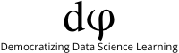
Learning Objectives
Data Splitting
Logistic Regression

Slide 3
Quick recap of some keywords!
Back to basics ;)

Slide 4
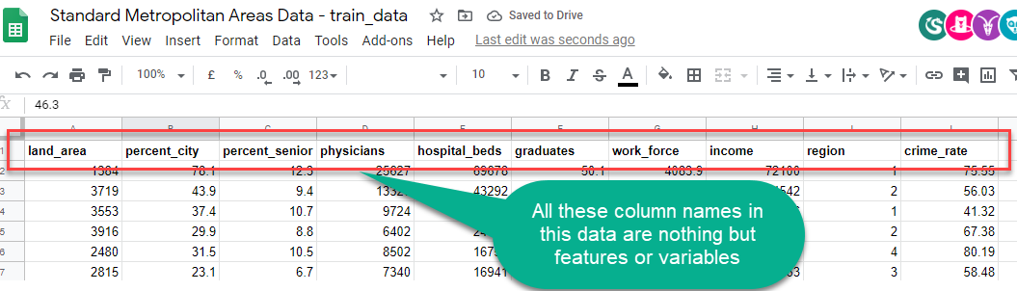
Variables/features
Features or Variables: These are the the most common terms that we would come across from now on.
Features and Variables both are the same in a dataset, they are often interchangeably used. So there is no need to worry about it!

Slide 5
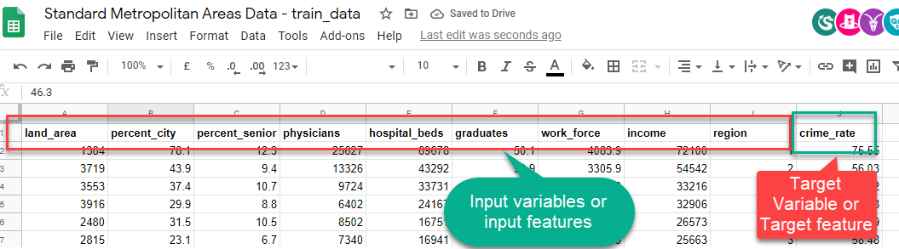
Target and Input variables
Remember the Standard Metropolitan Areas Data used in previous slides? In that dataset we might be curious to predict “crime_rate” in future, so that becomes our target variable and rest of the variables become input variables for building a machine learning model.

Slide 6
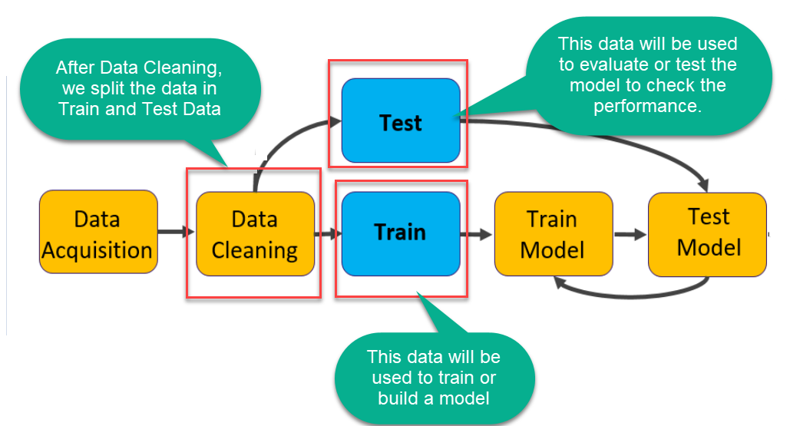
Train and Test Set
Data
Notes:
We b

Slide 7
We realized some of you are having a hard time with train and test dataset split. Please refer to the image in the next slide

Slide 8
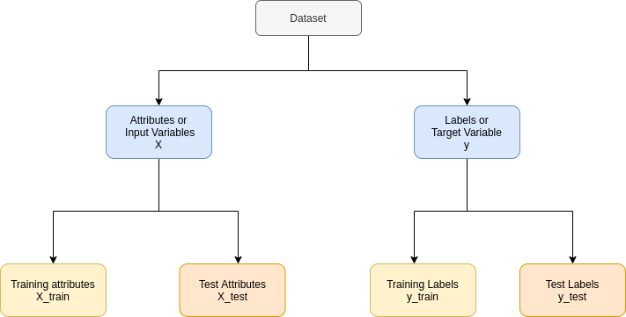
Data Splitting
We separate the data into input and target variable
We further divide them into train and test datasets

Slide 9
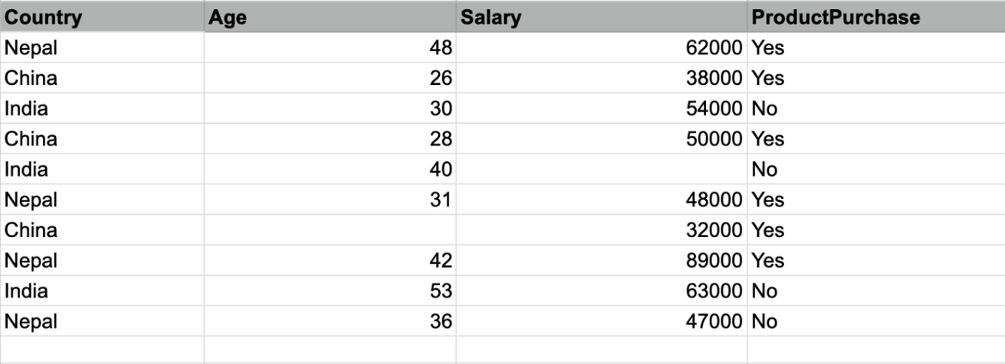
Data Splitting
Let’s consider the following data with 10 entries and our objective is to predict whether someone has purchased a product or not i.e “ProductPurchase” column = Yes or No
Here, Country, Age and Salary are the Input variables used to predict the target variable - ProductPurchase.

Slide 10
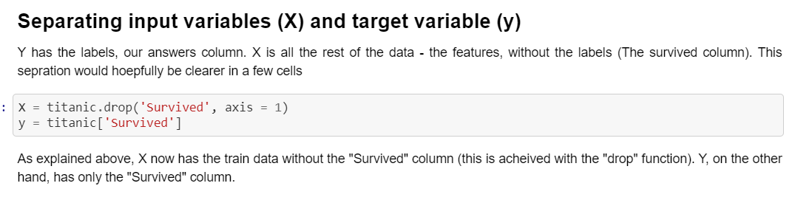
Separate Input and Target Variables
We separate the dataset into two new datasets one with input variables - X (Country, Age and Salary) and the other with target variable - y (ProductPurchase).
Adding a snippet from that we used in our first model building exercise.

Slide 11
Splitting into train and test datasets!
We’ll now split the x dataset into two separate sets — X_train and X_test.
Similarly, we’ll split the dataset y into two sets as well — y_train and y_test.
Reference here: https://github.com/dphi-official/First_ML_Model/blob/master/ML_with_titanic_data.ipynb

Slide 12
Logistic Regression!

Slide 13

Thing to note!
Never jump the gun!

Slide 14
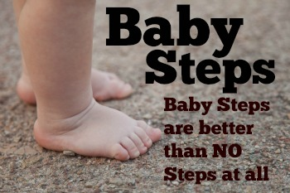
We can take baby steps and learnt things over time!

Slide 15
What’s next?
We learnt to build our first machine learning and also learnt about the 2 other ML models (Linear and Logistic Regression). This means we are already in the game and we know how to build models. Ofcourse, there will be ifs and buts, we might be confused because of too many terminologies, many models etc. That is totally common!
Now, let's take some baby steps to understand Logistic Regression. We learn the intuition behind the algorithm first and once we understand it well, we ourselves would be curious to learn the maths behind overtime.
Please note: Getting overwhelmed with maths or coding or tools shouldn’t be a blocker for the to learn data science!

Slide 16
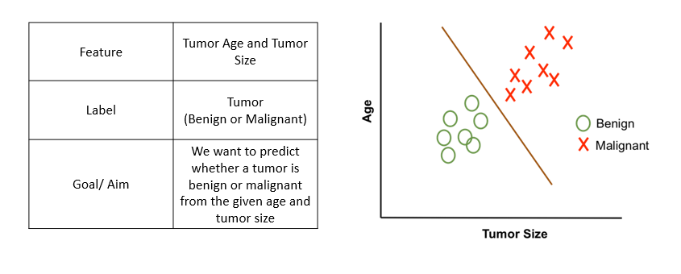
What is Classification?
Let’s learn with some examples:
In Classification we classify the outcome
Examples:
Predict whether a transaction is fraud or not fraud
Predict whether to give loan or not
Predict whether to give college admission or not
Predict the grade (Grade A, B, C, D)
Note: Classification can be more than two

Slide 17

What is Multi-Classification?
It is as simple as dividing waste into 4 categories - plastic, glass, metal, paper

Slide 18
Logistic Regression
Logistic Regression is one of the basic and popular algorithms to solve a binary classification problems
For each input, logistic regression outputs a probability that this input belongs to the 2 classes
Set a probability threshold boundary and that determines which class the input belongs to
Binary classification problems (2 classes):
Emails (Spam / Not Spam)
Credit Card Transactions (Fraudulent / Not Fraudulent)
Loan Default (Yes / No)

Slide 19
Logistic Regression
Now, you may ask why don’t we use Linear Regression? Why do we need a new algorithm?
Well, you would find all the answers in the video in the next slides.
The video in the next slide is a must watch, the instructor has brilliantly explained about logistic regression!

Slide 20
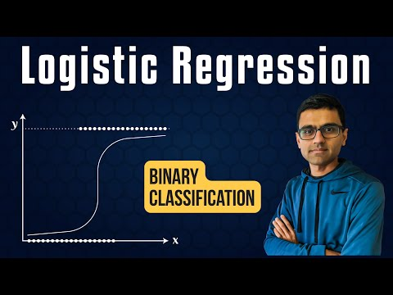
Must Watch Understanding Logistic Regression

Slide 21
Linear Regression vs Logistic
Linear regression is used to solve regression problems with continuous values
Logistic regression is used to solve classification problems with discrete categories
Binary classification (Classes 0 and 1)
Examples:
Emails (Spam / Not Spam)
Credit Card Transactions (Fraudulent / Not Fraudulent)
Loan Default (Yes / No)

Slide 22
Linear Regression vs Logistic
Let’s say a data scientist named John want to predict that whether a customer will buy insurance or not
Remember that linear regression is used to predict a continuous value where the output (y) may vary between +∞ (positive infinity) to -∞ (negative infinity) whereas in this case, the target variable (y) takes only two discrete values, 0 (No insurance) and 1 (Yes, got the insurance).
John’s decides to extend the concepts of linear regression to fulfil his requirement. One approach is to take the output of linear regression and map it between 0 and 1, if the resultant output is below a certain threshold (say 0.5), classify it as No (didn’t buy the insurance) whereas if the resultant output is above a certain threshold, classify it as bought the insurance (yes)

Slide 23
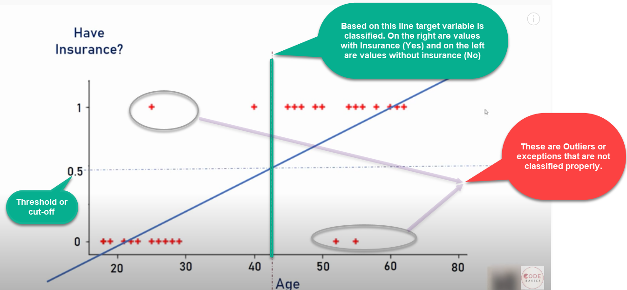
Linear Regression vs Logistic
We then plot a simple linear regression line and set the threshold as 0.5
Negative class (Insurance = No)– Age on the left side
Positive class (Insurance = Yes) – Age on the right side

Slide 24
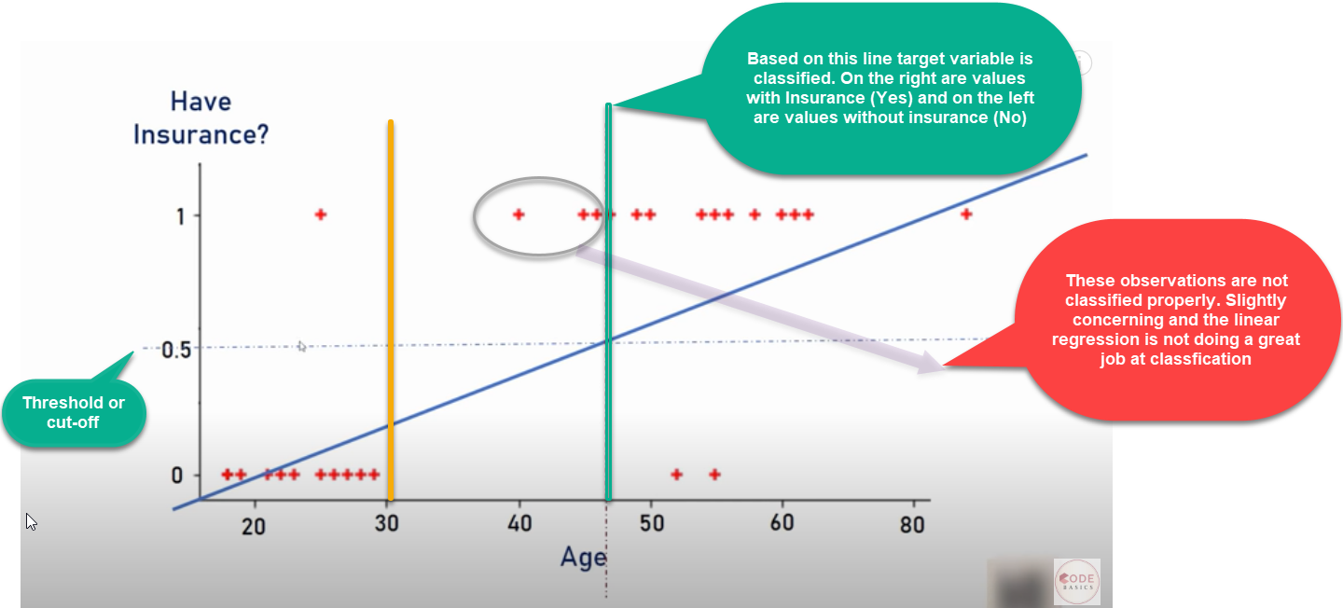
Imagine there is an outlier to towards right
Additional outlier that distorted the regression line
As we can see outlier in the data and will distort the whole linear regression line.
Clearly the line is unable to differentiate the classes with the linear line fit
The line should have been at the vertical yellow line which is able to divide the positive and negative classes i.e yes or no for insurance

Slide 25

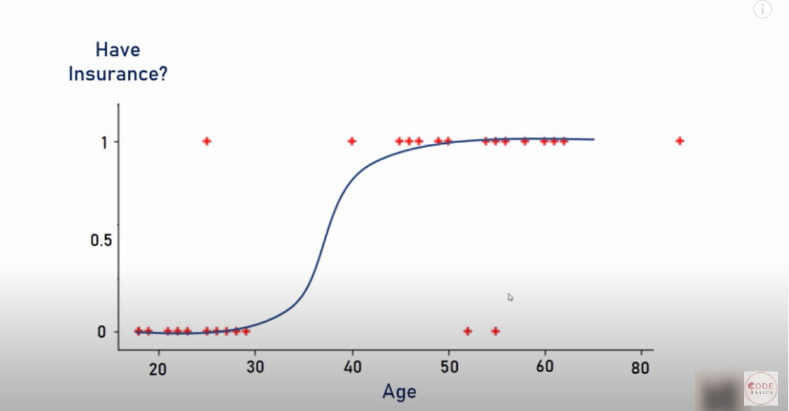
Happy John! (Data Scientist)
Well, life would be much simpler if we had a algorithm that
would fit the points like below right? It is a much better fit compared to regression line!

Slide 26
Solution
Solution – Transform linear regression to a logistic regression curve
Logistic regression is a Sigmoid function
Now what does this sigmoid function do?
Sigmoid function takes in any real value and gives a output probability between 0 and 1

Slide 27
Logistic vs Linear Regression
Linear regression is used to solve regression problems with continuous values
Logistic regression is used to solve classification problems with discrete categories
Binary classification (Classes 0 and 1)
It can be used for multi-classification problems too

Slide 28
Let’s understand some maths behind it! It is alright if you don’t understand just try to understand the intuition given in the previous slides

Slide 29
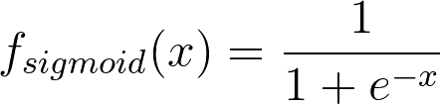
What are we doing in Logistic Regression?
We will use the real-valued output obtained from a linear regression model between 0 and 1 and classify a new example based on a threshold value. The function used to perform this mapping is the sigmoid function
The Sigmoid Function is represented by the formula:
There’s no need to go into the depth of how we obtained this formula right now.

Slide 30
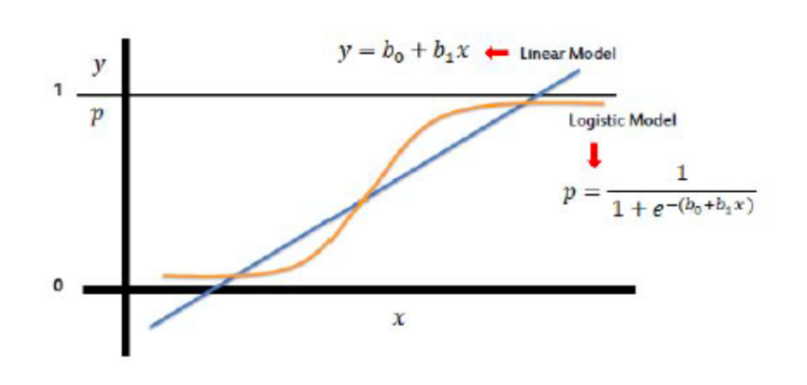
Sigmoid Function (Logistic Function/ Logit)
Take linear regression function and put it into the Sigmoid function
Sigmoid function outputs probability between 0 and 1

Slide 31
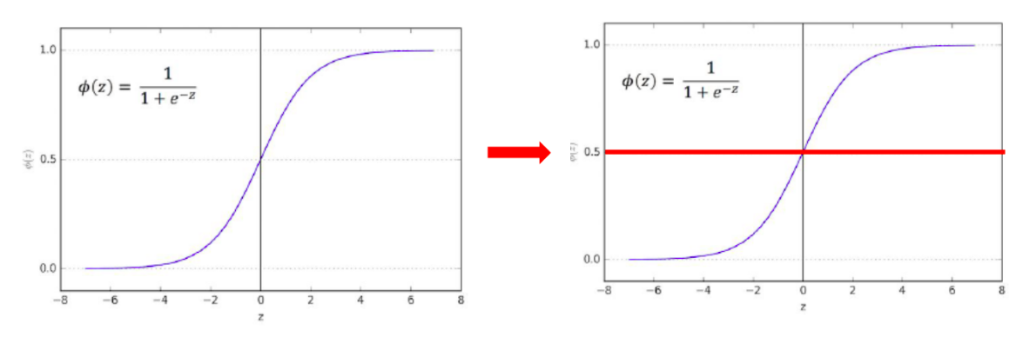
Sigmoid Function (Logistic Function/ Logit)
Sigmoid function outputs probability between 0 and 1
Default probability threshold is set at 0.5 typically
Class 0 – Below 0.5
Class 1 – Above 0.5

Slide 32
Types of Logistic Regression
Logistic Regression model can be classified into three groups based on the target variable categories:
Binary Logistic Regression
The target variable has two possible categories.
Common examples : 0 or 1, yes or no, true or false, spam or no spam, pass or fail, Transactions (Fraudulent / Not Fraudulent), Medical Condition (Diseased/ Not diseased)
Multi- Class Logistic Regression
Multinomial Logistic Regression
The target variable has three or more categories which are not in any particular order. So, there are three or more nominal categories.
Examples: Fruits (apple, mango, orange and banana), profession (e.g., with five groups: surgeon, doctor, nurse, dentist, therapist)
Ordinal Logistic Regression
The target variable has three or more ordinal categories. So, there is intrinsic order involved with the categories.
For example, the student performance can be categorized as poor, average, good and excellent.

Slide 33
We will be discussing about Multi-Class Logistic Regression in tomorrow’s module!

Slide 34
Notebook on Logistic Regression
https://github.com/dphi-official/ML_Models/blob/master/Logistic_Regression/logistic_regression.ipynb

Slide 35
Let’s do some practice
Instruction:
Use the raw data github link: https://raw.githubusercontent.com/dphi-official/Datasets/master/HR_comma_sep.csv
Or you can download it here from here
Exercise:
Load libraries and data.
Do some exploratory data analysis to figure out which variables have direct and clear impact on employee retention (i.e. whether they leave the company or continue to work)
Plot bar charts showing impact of employee salaries on retention
See the correlation between department and employee retention
Separate dependent and independent variables.
Split the data into train set and test set
Now build Logistic Regression model and do prediction for test data
Measure the accuracy of the model

Slide 36
Slide Download Link
You can download the slides here:
https://docs.google.com/presentation/d/10mkWll_9s8LkZpy-SzRWQjFr2ay6VppgpjkBVs2HSvM/edit?usp=sharing

Slide 37
That’s it for the day. Thank you!
Feel free to post any queries in the #help channel on Slack

